Slide 1
Why Do Research?
Coursework
Research Inside Courses
Research with Faculty
Radivonyk Fund
Q&A
Undergraduate and PlusOne Research: Opportunities and Pathways
Presentation by the Economics Department Undergraduate Research Committee
Committee Members:
Prof. Madhavi Venkatesan and Prof. Gustavo Vicentini
March 31, 2022
Presentation prepared by Prof. Angela Kilby
Undergraduate and PlusOne Research: Opportunities and Pathways

Slide 2
Outline of Talk
Why Do Research? Coursework Research Inside Courses Research with Faculty Radivonyk Fund Q&A
Why Do Research?
Coursework, Preparation, and Pathways
Research Inside Courses
Research with Faculty
Research For Credit/Transcript Notation Research For Pay
Applying to Economics Department Radivonyk Fund
Q&A
Undergraduate and PlusOne Research: Opportunities and Pathways

Slide 3
Why Do Research?
Coursework
Research Inside Courses
Research with Faculty
Radivonyk Fund
Q&A
Why Do Research?
Undergraduate and PlusOne Research: Opportunities and Pathways

Slide 4
What is research?
Why Do Research? Coursework Research Inside Courses Research with Faculty Radivonyk Fund Q&A
research (noun)
The systematic investigation into and study of materials and sources in order to establish facts and reach new con- clusions.
Types of research in economics:
Quantitative research
Qualitative research
Theoretical research
Undergraduate and PlusOne Research: Opportunities and Pathways

Slide 5
Why do research?
Why Do Research? Coursework Research Inside Courses Research with Faculty Radivonyk Fund Q&A
Preparation for private sector, government, or policy careers
Preparation for graduate school applications in economics or public policy
For economics Ph.D. programs: research can be pipeline to a “pre-doc” position
Learn more about your preferences/what you want to do with your life!
Undergraduate and PlusOne Research: Opportunities and Pathways

Slide 6
Two main “styles” of research opportunities as student at a university
Why Do Research? Coursework Research Inside Courses Research with Faculty Radivonyk Fund Q&A
Self-directed research (with mentor or instructor guidance)
Can be part of a class, for-credit (directed study), or on your own time
Generally: ask and answer your own question, produce your own paper
Can be data-centric, or not
Research assistantships
Can be paid, for-credit, or volunteer
Generally: support faculty research with qualitative or quantitative (data-oriented) assistance
Undergraduate and PlusOne Research: Opportunities and Pathways

Slide 7
Why Do Research?
Coursework
Research Inside Courses
Research with Faculty
Radivonyk Fund
Q&A
Coursework, Preparation, and Pathways
Undergraduate and PlusOne Research: Opportunities and Pathways

Slide 8
Preparation and pathways
Why Do Research? Coursework Research Inside Courses Research with Faculty Radivonyk Fund Q&A
The needs and fit of skills to any individual faculty’s research and interests will vary by faculty member
So if you are particularly interested in the work of a faculty member, start talking to them early in your academic career!
Generally, data skills are very helpful - many economics faculty need assistance with data and statistical programming, and they will increase your ability to do independent work. So:
Consider DS2000/2001 or a MISM course instead of the CS 1100 (Microsoft Office Course - but will be revamped!), to get exposure to R and Python
Take Statistics and Econometrics early in your academic career (exposure to R and Stata)
Take electives with data analysis and exposure to statistical
programming integrated
Take the classes of the faculty whose research you are interested in!
Undergraduate and PlusOne Research: Opportunities and Pathways

Slide 9
Why Do Research?
Coursework
Research Inside Courses
Research with Faculty
Radivonyk Fund
Q&A
Research Inside Courses
Undergraduate and PlusOne Research: Opportunities and Pathways

Slide 10
Research inside courses
Why Do Research? Coursework Research Inside Courses Research with Faculty Radivonyk Fund Q&A
Most basic way to dip your toe into research is to take a class that involves writing a research paper:
Writing Intensive in the Major NUPath designation indicates students write extensively
Econ 2560 Applied Econometrics
Econ 4692 Senior Economics Seminar (Capstone)
Econ 3470 American Economic History
Econ 3520 History of Economic Thought
Undergraduate and PlusOne Research: Opportunities and Pathways

Slide 11
Research inside courses
Why Do Research? Coursework Research Inside Courses Research with Faculty Radivonyk Fund Q&A
Most basic way to dip your toe into research is to take a class that involves writing a research paper:
Some electives also involve a research paper; some research papers involve working with data
Econ 3413 Health Economics and Health Care Policy (Kilby)
Econ 3916 Economics of Race (Venkatesan)
5000-level electives (open to JR/SR/Grad) and 7000 level electives such as Econ 7250 International Economic Development (Erten)
Undergraduate and PlusOne Research: Opportunities and Pathways

Slide 12
Research inside courses
Why Do Research? Coursework Research Inside Courses Research with Faculty Radivonyk Fund Q&A
This is not a comprehensive list, and courses change as instructors change
If in doubt, email professor in advance for syllabus/advice
Undergraduate and PlusOne Research: Opportunities and Pathways

Slide 13
Extending work done in courses
Why Do Research? Coursework Research Inside Courses Research with Faculty Radivonyk Fund Q&A
Can submit research papers to journals for publication, and conferences!
Econ Press
NU Writing Journal
CSSH Undergraduate Research Forum, where “students present their original research to peers and faculty”
Research, Innovation, Scholarship, and Entrepreneurship (RISE) fair
Undergraduate and PlusOne Research: Opportunities and Pathways

Slide 14
Why Do Research?
Coursework
Research Inside Courses
Research with Faculty
Radivonyk Fund
Q&A
Research with Faculty
Undergraduate and PlusOne Research: Opportunities and Pathways

Slide 15
Research with Faculty
Why Do Research? Coursework Research Inside Courses Research with Faculty Radivonyk Fund Q&A
There are a variety of options for doing research with faculty
Can be paid, for-credit, or volunteer
Can be either “style” of research – largely self-directed, or a research assistantship with the faculty member where you support their research
Some professors will only agree to mentor one “style” or the other
What makes sense will heavily depend on professor-student fit and relationship. Professors may evaluate you on:
Matching interests
Academic background (general/core coursework; whether you took their courses)
Relevant skills (which match the project and/or their research
needs); data skills and software languages often required
Your available time commitment
Undergraduate and PlusOne Research: Opportunities and Pathways

Slide 16
Why Do Research?
Coursework
Research Inside Courses
Research with Faculty
Radivonyk Fund
Q&A
Research For Credit/Transcript Notation
Undergraduate and PlusOne Research: Opportunities and Pathways

Slide 17
Research for credit/transcript notation
Why Do Research? Coursework Research Inside Courses Research with Faculty Radivonyk Fund Q&A
General procedure:
Identify a topic of interest, which must be in the economics field.
Identify a professor to work with, who must be an Econ professor.
Develop a research plan and determine the appropriate course.
Get approval from the professor and Department (Undergraduate Program Director).
Register via MyNortheastern → Registrar Forms → Individual Instruction form.
Undergraduate and PlusOne Research: Opportunities and Pathways

Slide 18
Research for credit
Why Do Research? Coursework Research Inside Courses Research with Faculty Radivonyk Fund Q&A
Undergraduate and PlusOne Research: Opportunities and Pathways

Slide 19
Research for transcript notation
Why Do Research? Coursework Research Inside Courses Research with Faculty Radivonyk Fund Q&A
Undergraduate and PlusOne Research: Opportunities and Pathways

Slide 20
Why Do Research?
Coursework
Research Inside Courses
Research with Faculty
Radivonyk Fund
Q&A
Undergraduate and PlusOne Research: Opportunities and Pathways

Slide 21
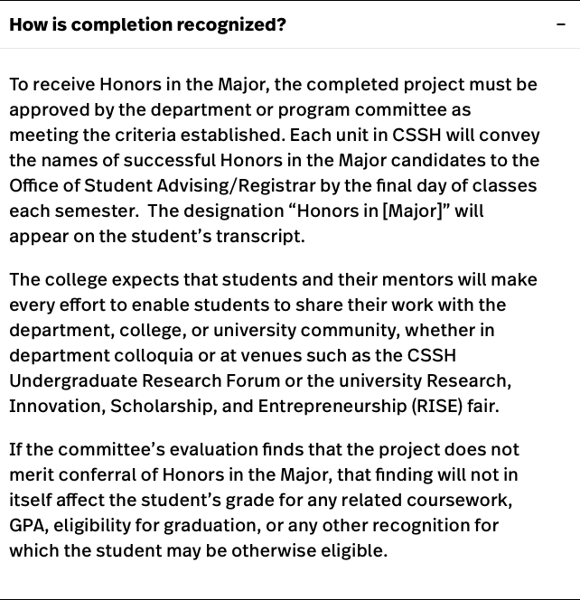
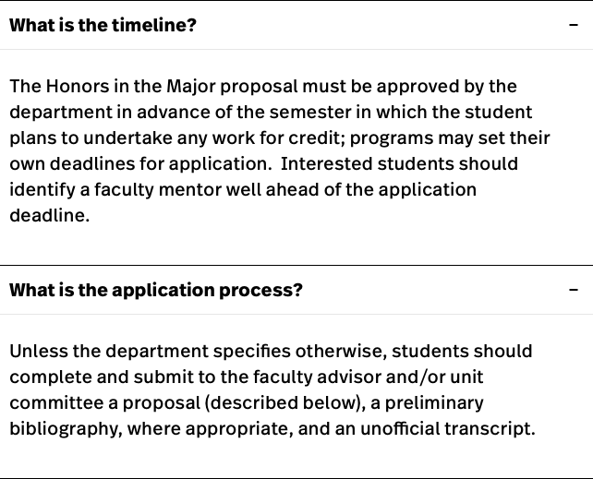
Why Do Research?
Coursework
Research Inside Courses
Research with Faculty
Radivonyk Fund
Q&A
https://cssh.northeastern.edu/research/honors-in-the-major/
Undergraduate and PlusOne Research: Opportunities and Pathways

Slide 22
Why Do Research?
Coursework
Research Inside Courses
Research with Faculty
Radivonyk Fund
Q&A
Research For Pay
Undergraduate and PlusOne Research: Opportunities and Pathways

Slide 23
Research for pay
Why Do Research? Coursework Research Inside Courses Research with Faculty Radivonyk Fund Q&A
There are an increasing number of funding sources to support
paid or stipended undergraduate research at Northeastern
At university level: PEAK awards
At college level: Undergraduate Research Initiative awards
At departmental level: Economics Department Radivonyk Fund Awards for Research
Undergraduate and PlusOne Research: Opportunities and Pathways

Slide 24
Northeastern University PEAK Awards
Why Do Research? Coursework Research Inside Courses Research with Faculty Radivonyk Fund Q&A
https://undergraduate.northeastern.edu/research/research-opportunities/ resources/
Undergraduate and PlusOne Research: Opportunities and Pathways

Slide 25
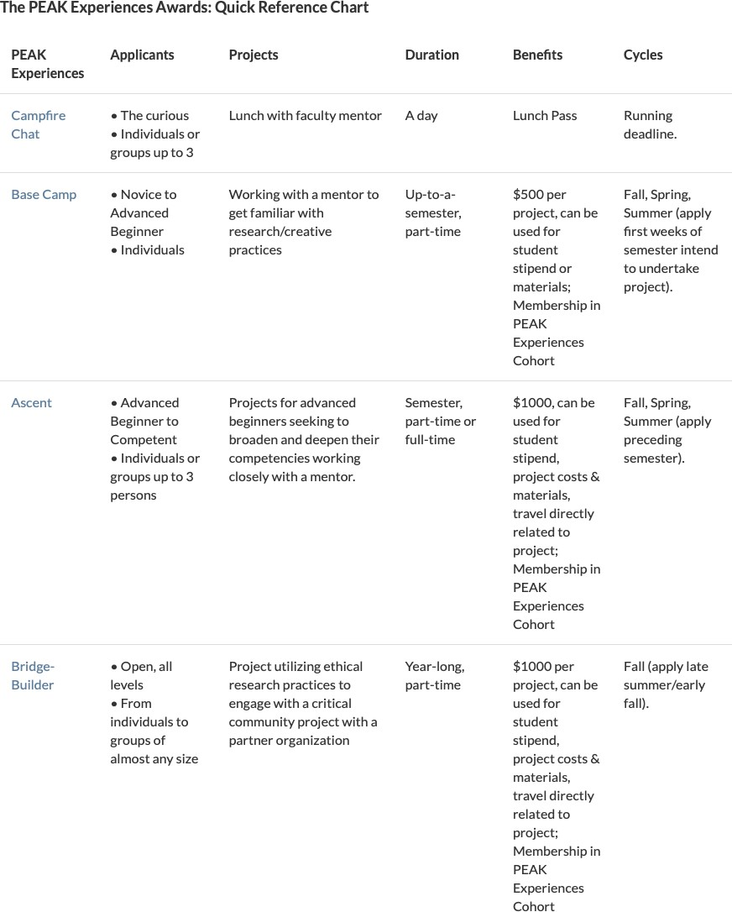
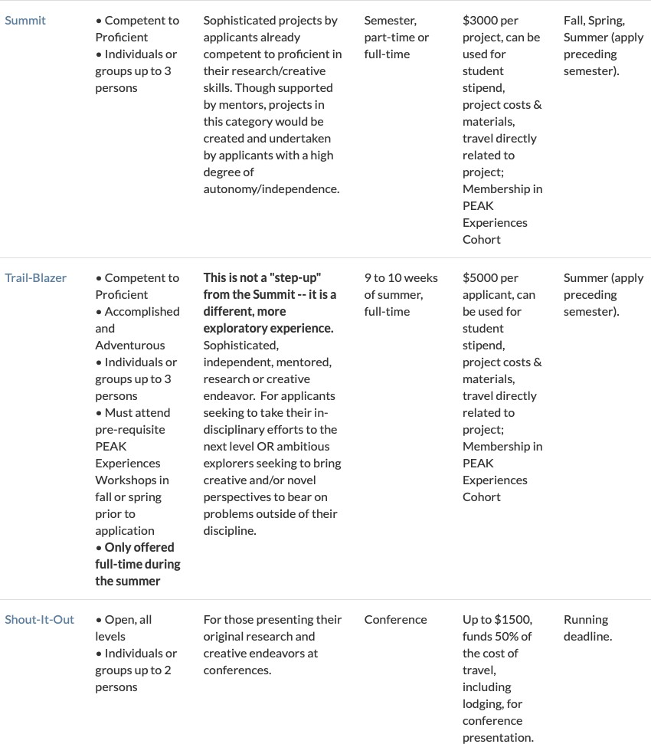
Northeastern University PEAK Awards
Why Do Research? Coursework Research Inside Courses Research with Faculty Radivonyk Fund Q&A
Undergraduate and PlusOne Research: Opportunities and Pathways

Slide 26
Northeastern University PEAK Awards
Why Do Research? Coursework Research Inside Courses Research with Faculty Radivonyk Fund Q&A
Deadlines depend on award and desired semester. For example,
Ascent (up to $1,000) due 4/1 for summer
Summit (up to $3,000) due 4/1 for summer
Trail-blazer (up to $5,000) due 3/5 for summer
Undergraduate and PlusOne Research: Opportunities and Pathways

Slide 27
CSSH Undergraduate Research Initiative Awards
Why Do Research? Coursework Research Inside Courses Research with Faculty Radivonyk Fund Q&A
Undergraduate and PlusOne Research: Opportunities and Pathways

Slide 28
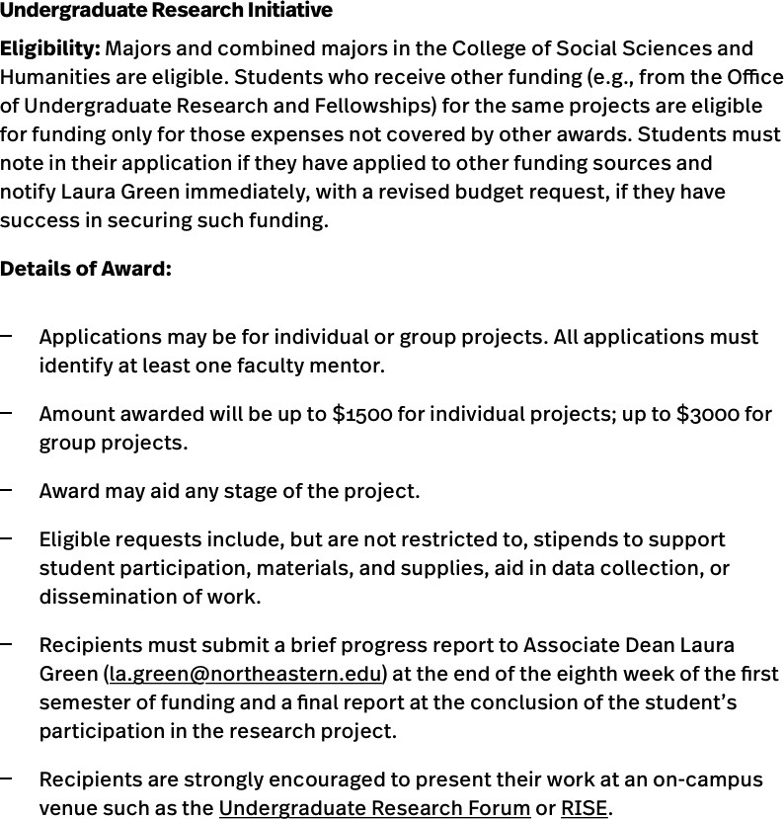
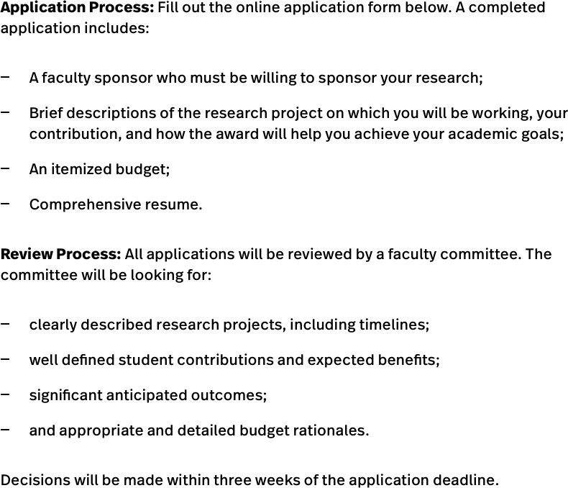
CSSH Undergraduate Research Initiative Awards
Why Do Research? Coursework Research Inside Courses Research with Faculty Radivonyk Fund Q&A
https://cssh.northeastern.edu/undergraduate-research-initiative/
Undergraduate and PlusOne Research: Opportunities and Pathways

Slide 29
Economics Department Radivonyk Fund Awards for Research
Why Do Research? Coursework Research Inside Courses Research with Faculty Radivonyk Fund Q&A
Radivonyk Fund is a fund intended to support undergraduate and PlusOne research in the economics department
Applications are relatively simple/straightforward
Key goal is the initiation of research collaborations between students and faculty which turn into applications to college URI awards and university PEAK awards
Undergraduate and PlusOne Research: Opportunities and Pathways

Slide 30
Why Do Research?
Coursework
Research Inside Courses
Research with Faculty
Radivonyk Fund
Q&A
Applying to Economics Department Radivonyk Fund
Undergraduate and PlusOne Research: Opportunities and Pathways

Slide 31
Applying to Economics Department Radivonyk Fund
Why Do Research? Coursework Research Inside Courses Research with Faculty Radivonyk Fund Q&A
Faculty member and student prepare a joint proposal comprising:
1 page of narrative (single spaced, 12 point font) of
Description of research project
Tasks to be completed by student
Details of faculty supervisory role (important)
Deliverables (strongly suggested that deliverables include a plan to apply to the university PEAK awards in a later semester)
Budget, where funding can be used to pay stipend or buy data/supplies
Proposal should be signed by student and faculty member, and emailed to the committee via Katie Thorp (k.thorp@northeastern.edu)
Next deadline is TBD.
Undergraduate and PlusOne Research: Opportunities and Pathways

Slide 32
Why Do Research?
Coursework
Research Inside Courses
Research with Faculty
Radivonyk Fund
Q&A
Q&A
Undergraduate and PlusOne Research: Opportunities and Pathways

